Slide 1



DEEP LEARNING HCL - MINI PROJECT TITLE: Railway Equipment Failure Prediction using LSTM PROJECT MEMBERS: 24ADR006 – AKELESHWAR S K 24ADR007 – AKIL S 24ADR051 - HARINI K K
KONGU ENGINEERING COLLEGE
PERUNDURAI ERODE-638060
ARTIFICIAL INTELLIGENCE &
DATA SCIENCE

Slide 2
PROBLEM STATEMENT
Railway equipment operates continuously under varying conditions
Failures can occur due to wear, overheating, or stress
Leads to:
Train delays
High maintenance cost
Safety risks
Traditional maintenance is reactive and inefficient
Need for predictive maintenance system

Slide 3
LITERATURE SURVEY
Traditional methods use rule-based or statistical models.
Machine Learning models (SVM, Random Forest) used for prediction.
Deep Learning models improve accuracy
LSTM (Long Short-Term Memory):
Captures long-term dependencies
Suitable for time-series prediction
GRU (Gated Recurrent Unit):
Faster than LSTM
Less computational complexity

Slide 4
OBJECTIVE
Predict machine failure using sensor data
Use LSTM and GRU models
Compare model performance
Provide real-time decision support
Reduce maintenance cost and downtime
Build an accurate deep learning model

Slide 5
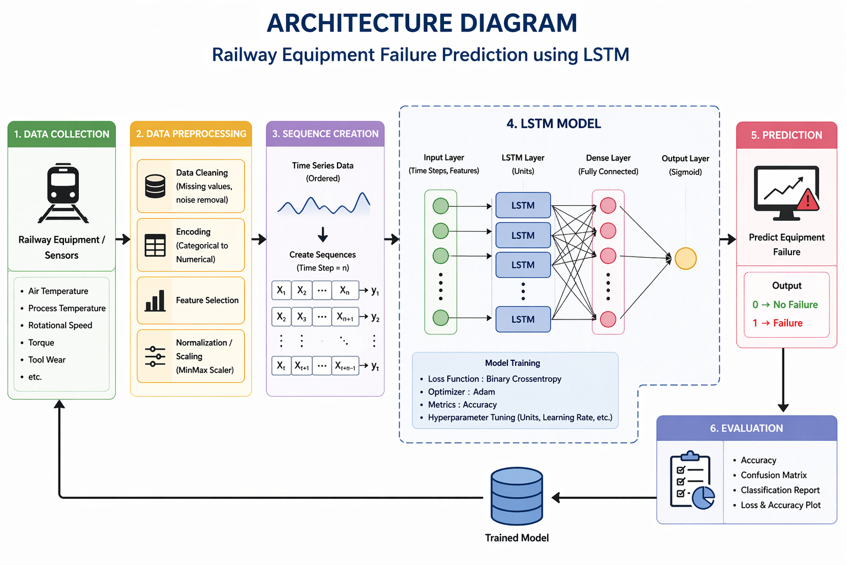
ARCHITECTURE DIAGRAM

Slide 6
DATASET DESCRIPTION
Dataset
Dataset: AI4I 2020 Predictive Maintenance Dataset
Source: UCI Machine Learning Repository
Total Records: 10,000
Used for machine failure prediction
Features Used Target
Air Temperature 0 → No Failure
Process Temperature 1 → Failure
Rotational Speed
Torque
Tool Wear
Preprocessing
Data normalization using MinMaxScaler
Sequence creation for LSTM and GRU
Train-test split performed
Purpose
To predict railway equipment failure using deep learning models.

Slide 7
MODULES EXPLANATION
Data Collection Module
Loads the dataset
Collects sensor data for prediction
Data Preprocessing Module
Cleans and normalizes data
Converts data into sequence format
Model Training Module
Trains LSTM and GRU models
Performs hyperparameter tuning
Prediction Module
Predicts machine failure
Generates Failure / No Failure output
Evaluation Module
Evaluates model performance
Uses accuracy and confusion matrix
Web Application Module
Displays prediction results
Provides real-time user interface

Slide 8
PERFORMANCE METRICS
Accuracy
Measures overall prediction correctness
Precision
Measures correct failure predictions
Recall
Measures ability to detect actual failures
F1-Score
Balances precision and recall
Confusion Matrix
Shows correct and incorrect predictions
RMSE
Measures prediction error rate
MAE
Measures average prediction error
Model Comparison
Compares LSTM and GRU performance

Slide 9
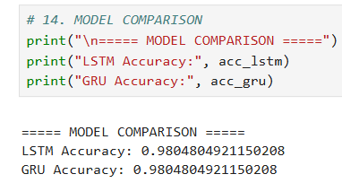
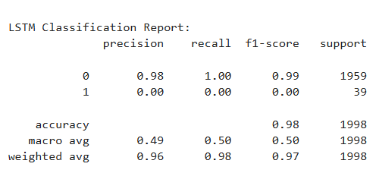
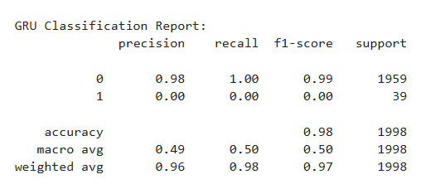
SCREEN SHORTS
Accuracy Model Comparison
LSTM CLASSIFICATION REPORT
GRU CLASSIFICATION REPORT

Slide 10
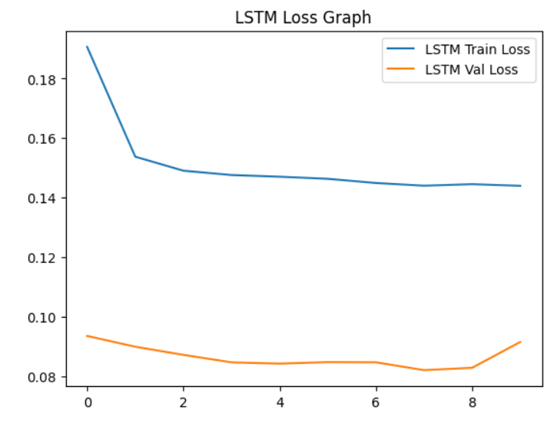
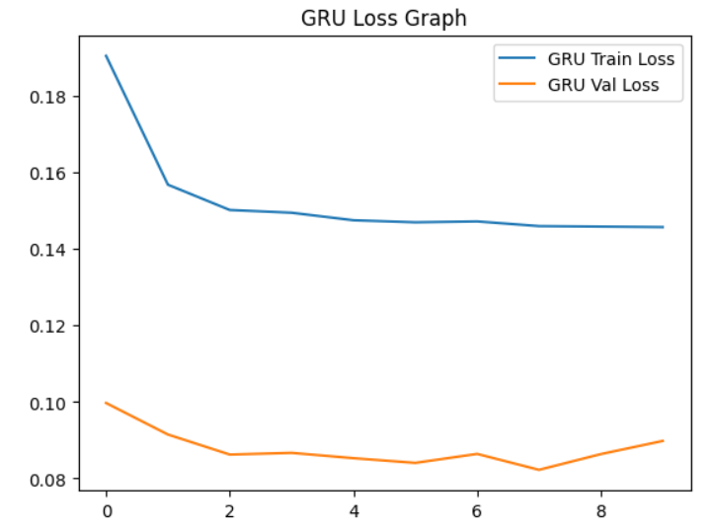
SCREEN SHORTS
LSTM LOSS GRAPH
GRU LOSS GRAPH

Slide 11
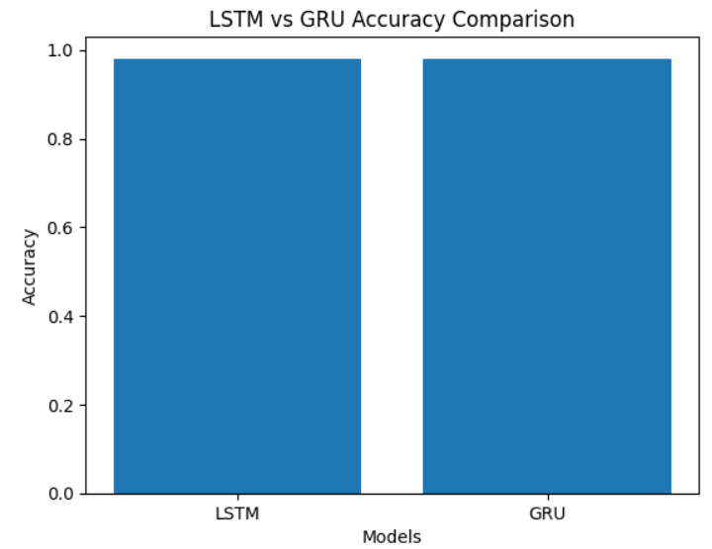
SCREEN SHORTS
LSTM vs GRU ACCURACY COMPARISON

Slide 12
RESULTS ACHIEVED
Successfully developed railway equipment failure prediction system
Implemented LSTM and GRU deep learning models
Achieved accurate failure prediction using sensor data
Compared performance of LSTM and GRU models
Reduced false predictions using hyperparameter tuning
Generated real-time Failure / No Failure results
Developed Flask-based web application for prediction
Improved predictive maintenance and railway safety

Slide 13
CONCLUSION
Developed an intelligent railway equipment failure prediction system
Used LSTM and GRU deep learning models for predictive maintenance
Achieved accurate prediction using sensor data analysis
Compared the performance of LSTM and GRU models
Reduced maintenance cost and unexpected equipment failures
Improved railway safety through early failure detection
Successfully implemented a real-time web-based prediction system

Slide 14
REFERENCE
Dataset
UCI Machine Learning Repository https://archive.ics.uci.edu/ml/datasets/AI4I+2020+Predictive+Maintenance+Dataset
LSTM Research
Hochreiter, S., & Schmidhuber, J. (1997) Long Short-Term Memory https://doi.org/10.1162/neco.1997.9.8.1735
GRU Research
Cho, K. et al. (2014) Learning Phrase Representations using RNN Encoder–Decoder https://arxiv.org/abs/1406.1078
Deep Learning Book
Goodfellow, I., Bengio, Y., Courville, A. Deep Learning https://www.deeplearningbook.org
TensorFlow Documentation
TensorFlow Official Docs https://www.tensorflow.org
Scikit-learn Documentation
Scikit-learn https://scikit-learn.org

Slide 15
THANK YOU

